Slide 1


Featured Alumna
CAREER SERVICES
Julie Dymon, ’11
Bachelor of Liberal Studies in English, concentration in Creative Writing
Alumni Corner ~ Best Practices:
Create an Online Portfolio
B.A., Psychology
Professors Jim Groom, Anand Rao and Zach Whalen all suggested creating an online professional profile to help with our future job search. The use of multimedia adds to the depth and dimension of the portfolio, breathing life into the typical two dimensional resume, making it a memorable presentation of you and your accomplishments that should stand out in the mind of potential employers.
The site also displays my technical skill in website development and design. For ideas, do some Google searches by author (ask friends and professors for their site addresses) and view as many online portfolios as you can to start formulating your own ideas of what works and what doesn’t work in any given profile.

Slide 2
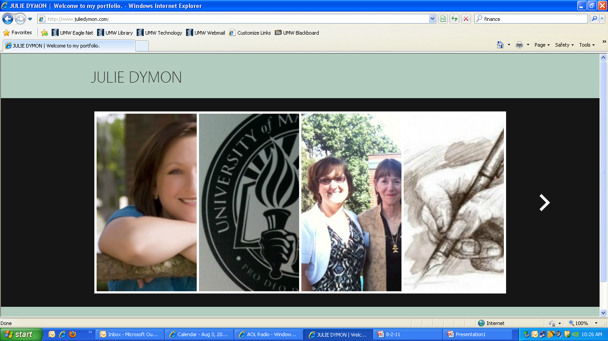
Alumni Corner ~ Best Practices:
CAREER SERVICES
Julie Dymon, ’11
Bachelor of Liberal Studies in English, concentration in Creative Writing
Create an Online Portfolio
AVT Event Technologies
Area Business Center Manager
What to Consider?
Make sure to note what you like about another person's profile, but make it your own. Always give credit where credit is due if you are using something that is directly someone else's work and make sure you have received their permission to do so. While you are at UMW, try to take a course or participate in a project that focuses on website development.
One of the biggest things to keep in mind is that this could be your first impression to a potential employer. How do you want them to see you? Consider that during your website development and work to get the site exactly like you want it. I'm constantly tweaking mine as I find better ways to say things or present the material.

Slide 3
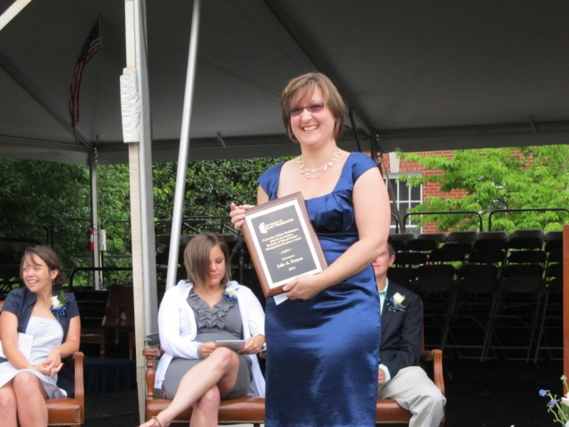
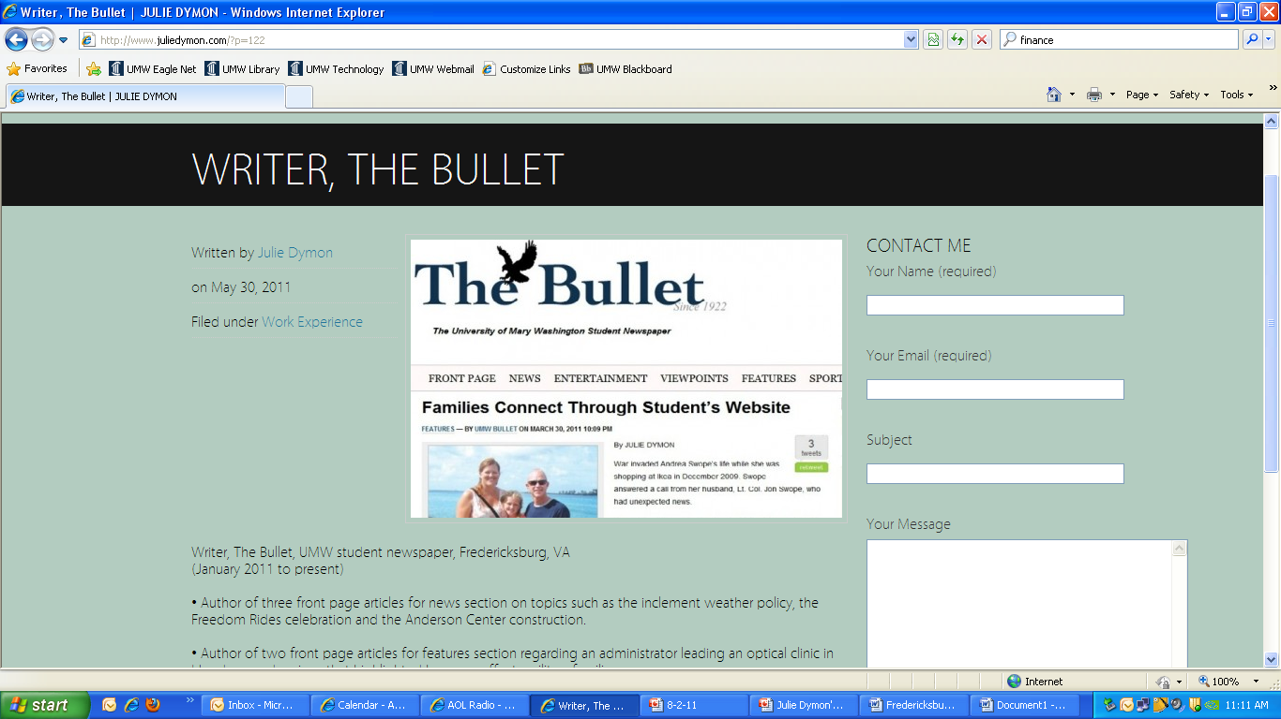
Alumni Corner
CAREER SERVICES
Julie Dymon, ’11
Bachelor of Liberal Studies in English, concentration in Creative Writing
Create an Online Portfolio
You have to market yourself in today's job search, because anyone can hand in a resume and there are more workers than jobs. To stand out, you have to put forth a little more effort than the next guy. This online profile is a great way to do so. I have received some great feedback on my website from professors, friends and professionals.
AVT Event Technologies
Area Business Center Manager
How has Julie used the online portfolio in her job search?
I have placed my website www.juliedymon.com on every resume I submit whether via snail mail, email or online attachment. I have my website listed on my Facebook, Twitter and LinkedIn pages and have created a signature line for my emails that include it.

